Slide 1
Dimension Reduction on Heart Disease

Slide 2

ABOUT
This study aims to analyse the Heart Attack dataset and will apply Dimensionality Reduction techniques eventually building a classification model to do the predictions.
The dataset includes a sample of patients within the age group of 29 and 77 years. The data is segregated between males and females.

Slide 3
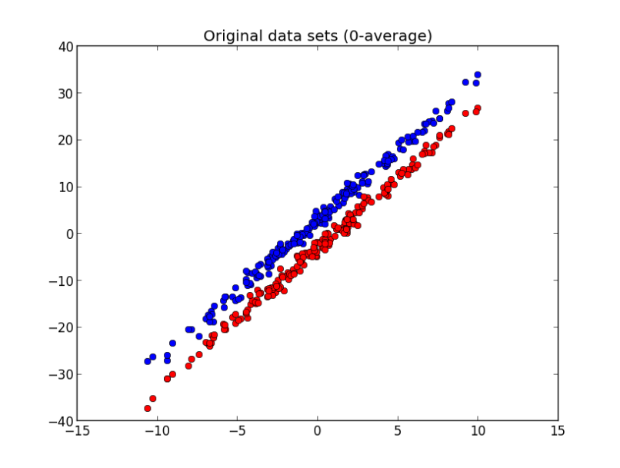
Objective
Analysis and exploring different methods for Dimensionality Reduction and choosing the optimal technique.
Applying data wrangling techniques to perform exploratory data analysis to find the insights from the data and handle any discrepancies.
Comparison on different Machine learning models and compare their accuracy metrics.
Predicting heart failure on basis of different attributes like cholesterol, chest pain type, etc. and comparison with the true/actual values.
This Photo by Unknown Author is licensed under CC BY-NC

Slide 4






DATASET
Variables
Variable Classification
Missing Values
14 Variables
2216 Observations
6 Numerical
8 Categorical
No Missing Values
Age Group
Source
Between
29 and 77 Years
Kaggle
Heart Disease

Slide 5
Variables
age: Age of Patient
sex: Sex of Patient
exang: exercise included angina ( 1 = yes, 0 = no )
ca: number of major vessels (0-3)
cp: chest pain type ( 1: typical angina,2: atypical,3: non-anginal,4: symptomatic)
trbps: resting blood pressure
chol: cholesterol
fbs: fasting blood sugar
Oldpeak (ST Depression induced by exercise relative to rest)
Slp (speech language pathology)
Thall (Thallasemia)
rest_ecg: resting electrographic results (0,1,2)
thalach: maximum heart rate achieved
target: (0: less chance of heart_attack, 1: more chance of heart attack)

Slide 6

Literature Review

Slide 7
PAPER – 1
Linear discriminant analysis and principal component analysis to predict coronary artery disease
This paper is analyzing a dataset for coronary artery disease which is the most chronic disease in the modern world. This paper emphasizes on the fact that different articles have exploited data mining where researchers like Shouman et al, have preferred K-NN whereas Chaurasia et al. have used decision trees for their analysis. Other studies highlighted LDA, and some studies go with the combination of PCA and LDA. In this paper, authors have applied supervised data mining technique over 10,265 patients for Coronary artery disease.
When researchers gather the data from patients admitted to the department of advanced biomedical sciences. This analysis was implemented in two different ways. Firstly, LDA was performed and then PCA and LDA together and when key scores like accuracy, precision, recall were found better in the latter case. The quality of the data is significantly connected with the analysis's findings, with lower scores indicating lower-quality data. Its application in healthcare facilities to assist clinicians with decision-making would be encouraged by increasing the scores obtained using the LDA and PCA algorithms. Researchers also realized that the quality of the data and other limitation with the pre-processing pipeline. At the end, researchers put emphasis on the fact that PCA needs further investigation.
In the future, PCA could be used in other healthcare settings to reduce the number of features while supplying "new ones" (principal components) that are just as valid as the original ones.

Slide 8
PAPER – 2
Principal Component Analysis based on data characteristics for dimensionality reduction of ECG recordings in arrhythmia classification
The computerization of heart disease diagnostics is becoming increasingly crucial due to the heart disease epidemic. Cardiac arrhythmias are among the most widespread heart conditions. ECG measurements of the heart's activity are typically used to diagnose it, and the data are then gathered as multidimensional medical datasets. Their analysis, storage, and information extraction, however, become extremely challenging problems.
The process of data interpretation is largely gone by feature reduction, which also makes it possible to conserve storage and resources. Researchers have analysed the feature extraction and feature selection techniques but realized mostly are based on PCA and FA. PCA, will reduce the features and in this thesis, ig-PCA (in-group PCA) is used on the “Arrhythmia” dataset from UCI repository.
This research paper has applied in-group PCA to improve handling the ECG recordings in the medical field, specifically arrhythmia classification where it comes with multidimensional data. Then Researchers assumes that dataset can be divided into subgroups with similar characteristics and then subjected to PCA. And as ig-PCA has outperformed base PCA in terms of classification accuracy. Researchers have also mentioned that each medical study has its own design and data structure and hence there is no universal statistical method that can deal with all kinds.

Slide 9

Exploratory Data Analysis

Slide 10
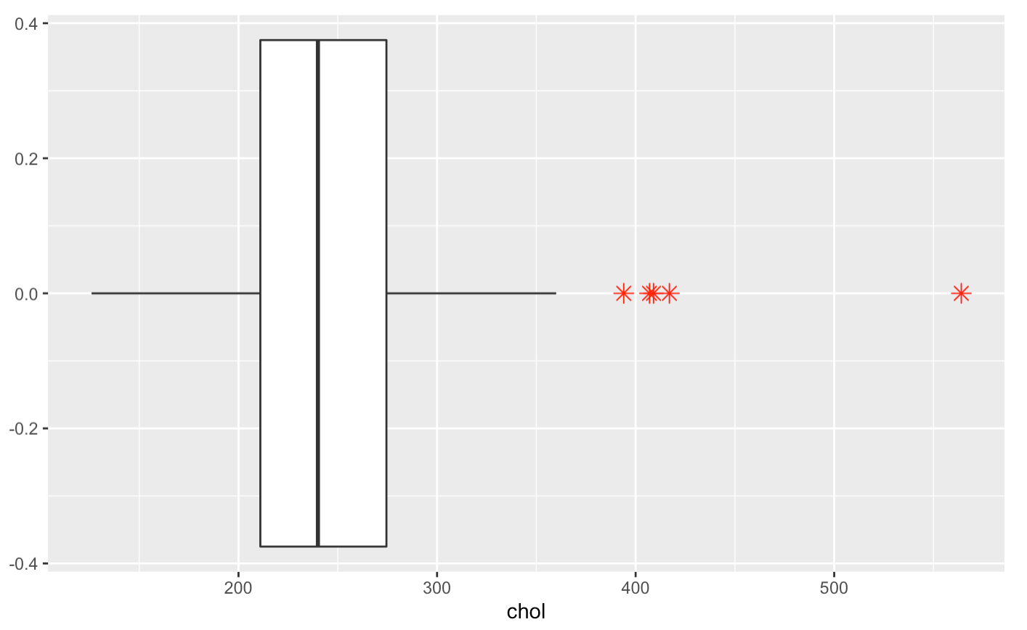
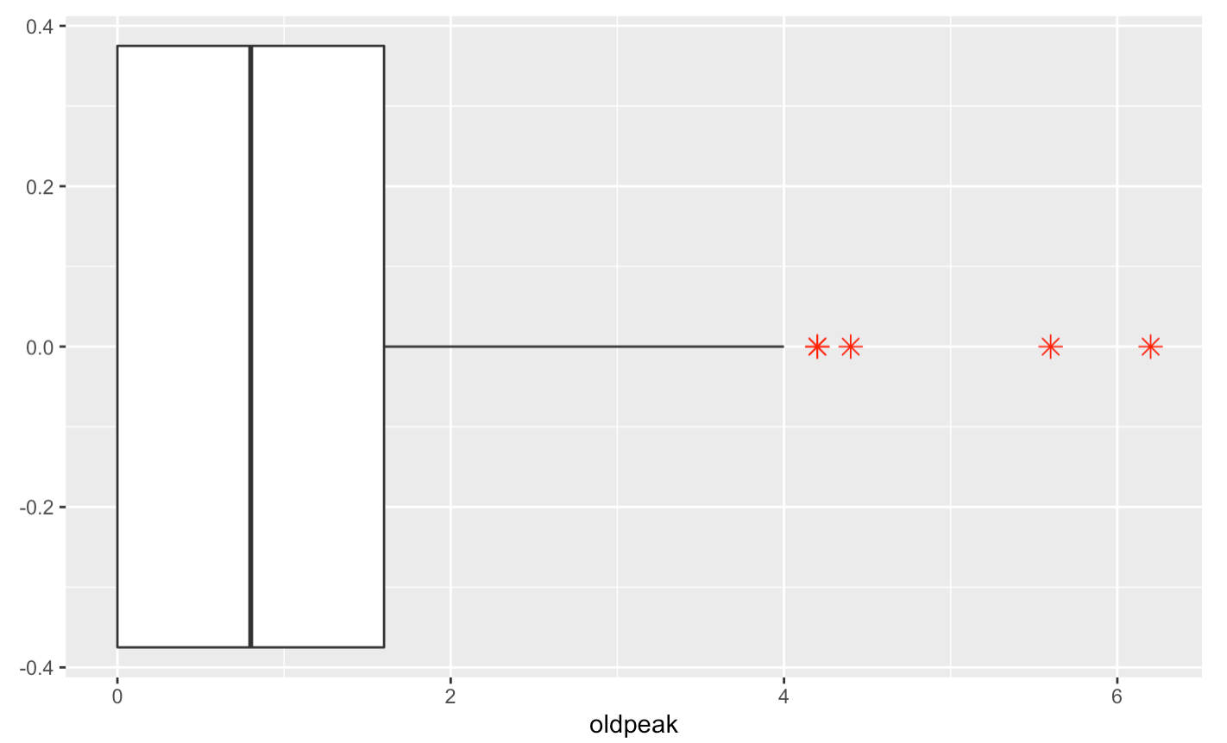
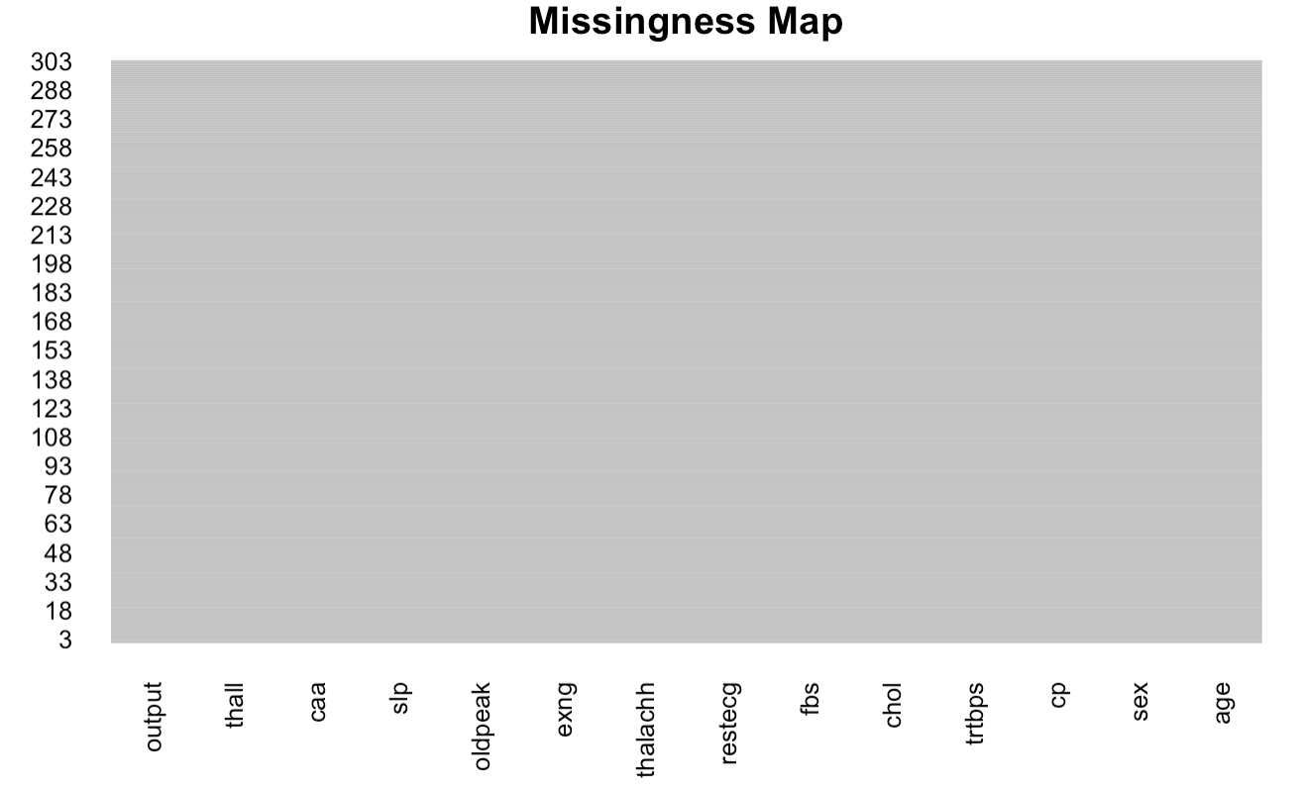
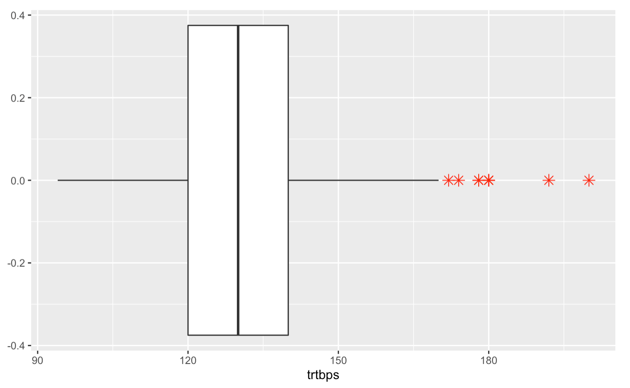
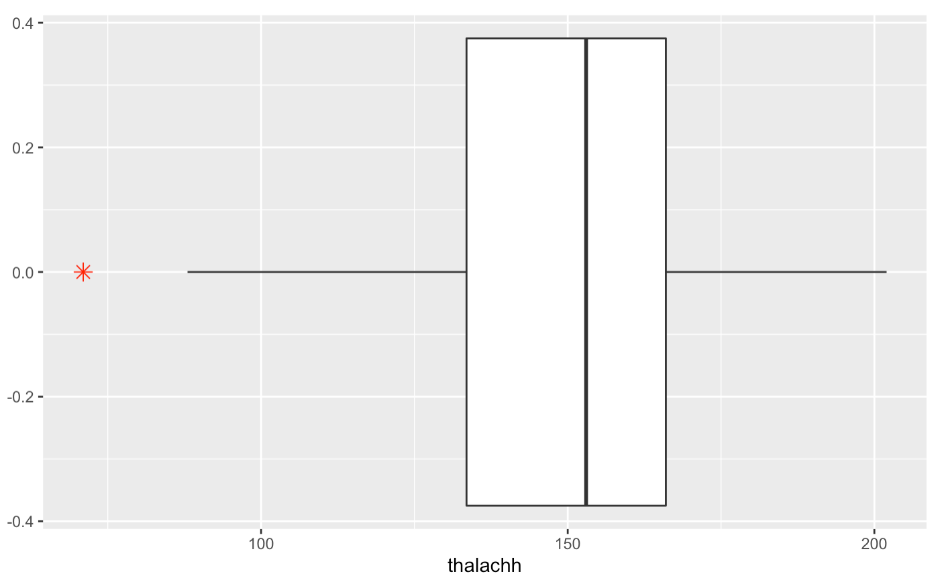
MISSING VALUES
OUTLIERS
Chol
OldPeak
The Missing Map shows that there are no missing values in the dataset.
Trtbps
Thalachh

Slide 11
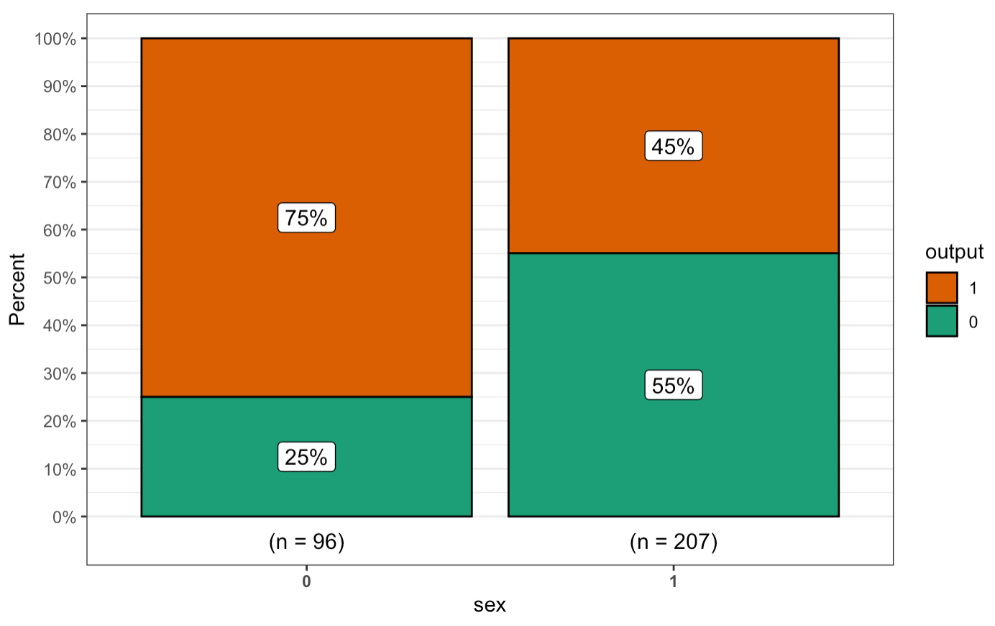
DATA PROPORTION GENDER WISE
The split bar graph shows the proportion of the people having heart disease based on the gender.
The heart issues shows that females tend to have more risk to heart failure.

Slide 12
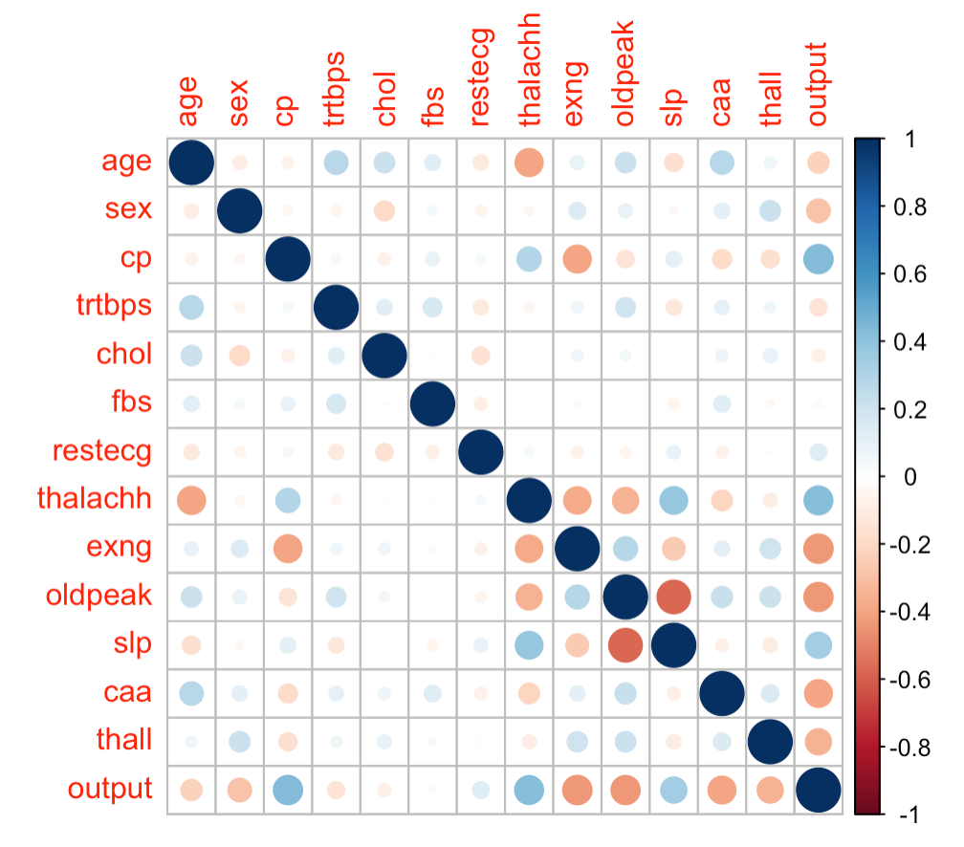
CORRELATION
Based on the correlation matrix, the correlation plot is generated shows the relationships between the variables.

Slide 13
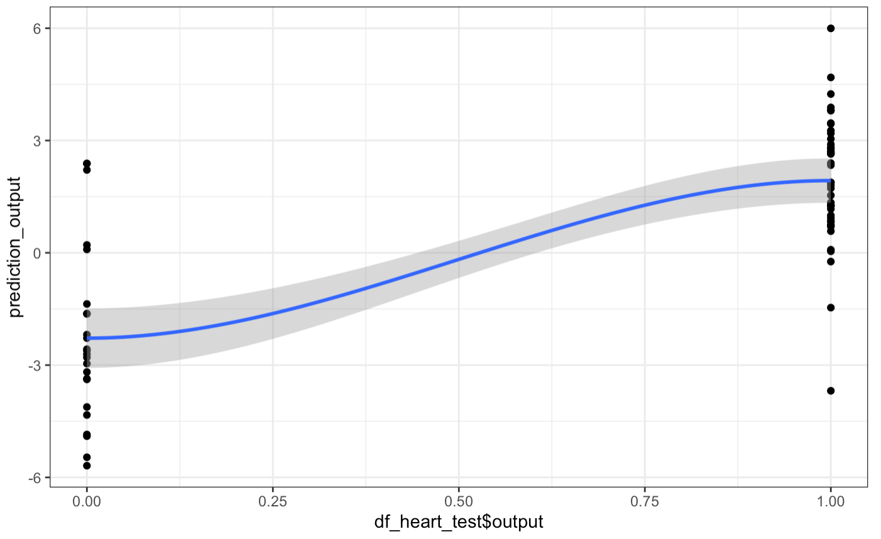
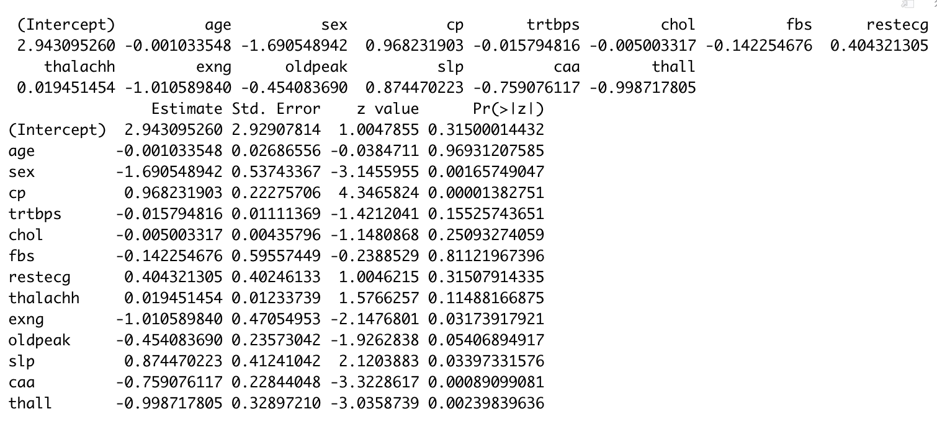
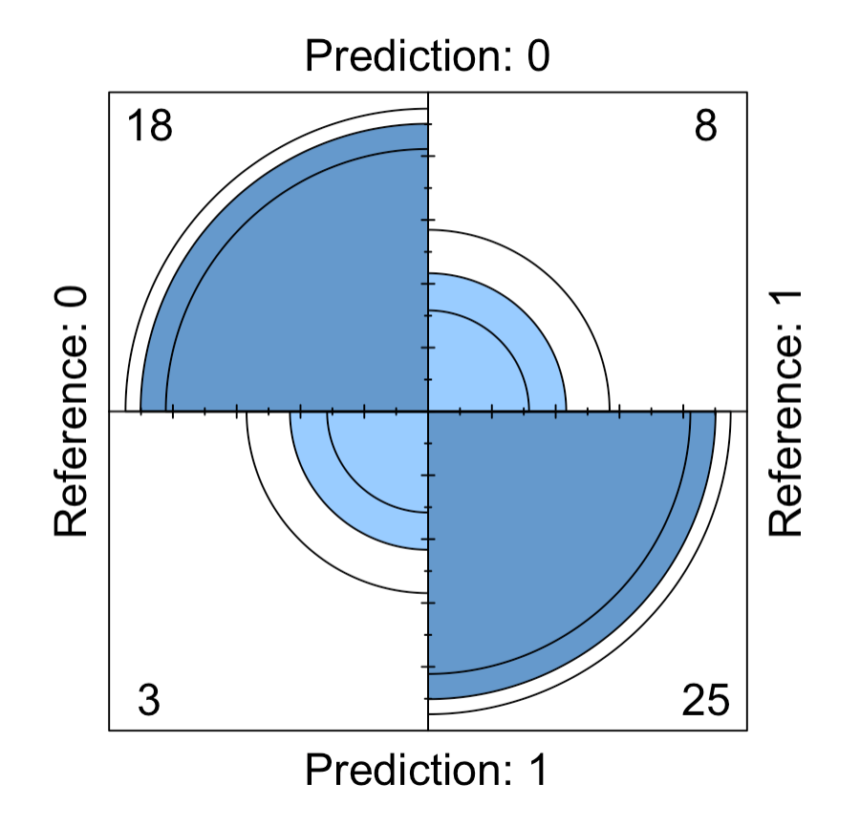
MODELLING
Data Split
Train = 80% Test = 20%
Logistic Model
Target ~ All Variables
Accuracy
~ 79.6%

Slide 14

Dimension Reduction

Slide 15
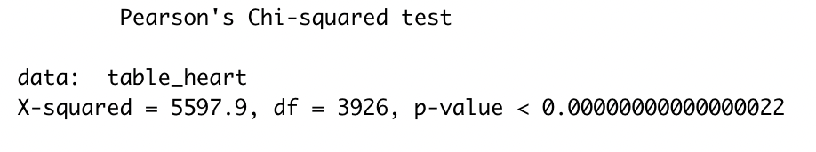
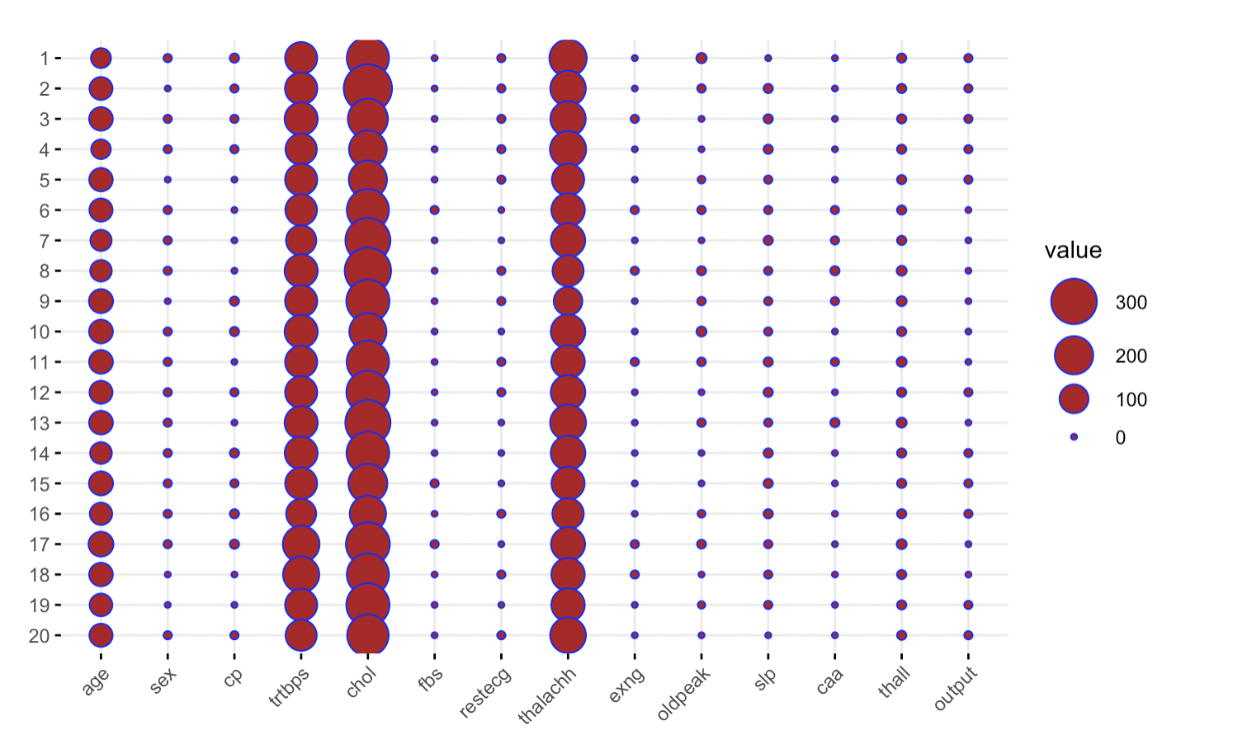
CORRESPONDANCE ANALYSIS
The row and the column variables are statistically significantly associated as our p-value < 0.05.
This plot shows the larger the circle, the larger the entry.

Slide 16
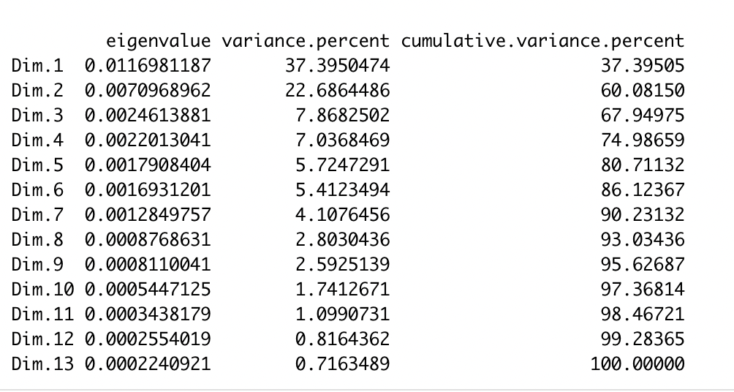
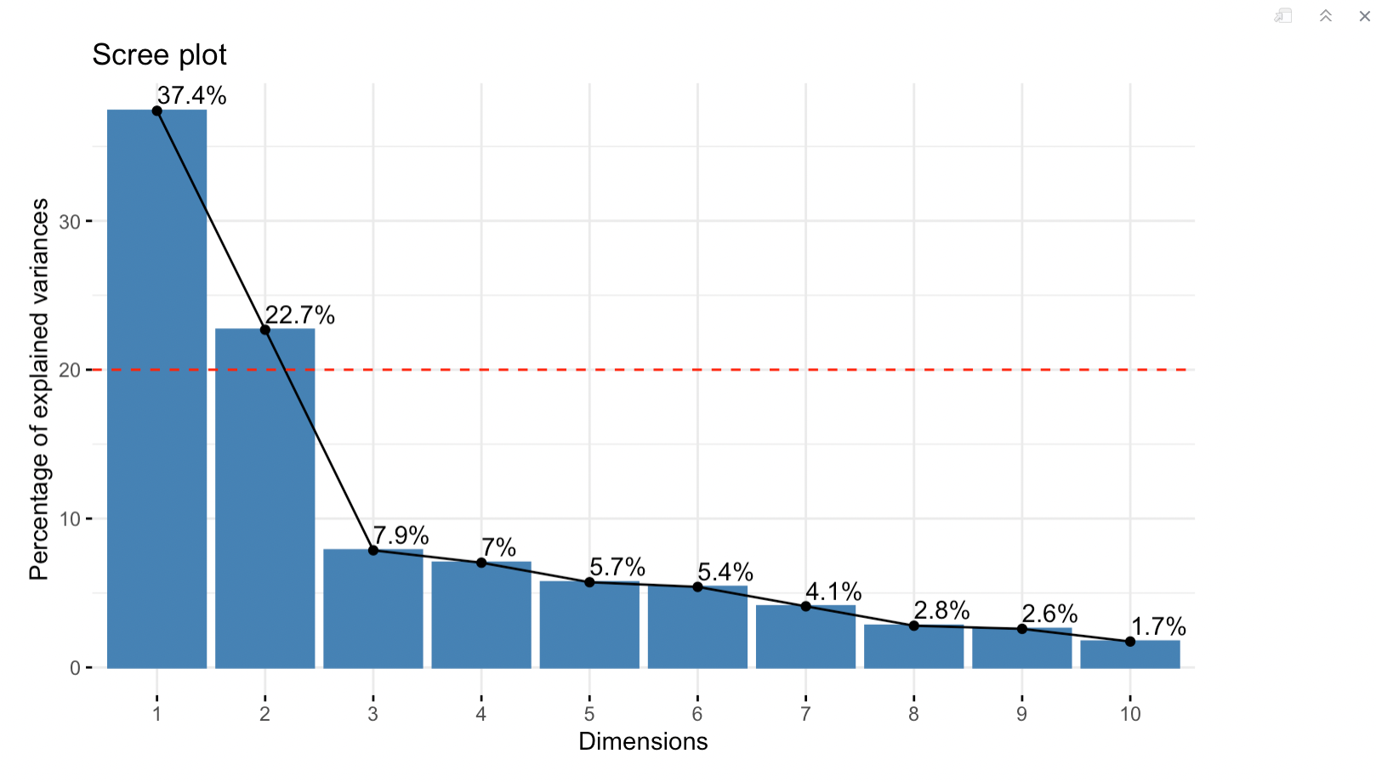
First two dimensions are overpassing the 70% threshold.
Scree Plot also shows a huge bend after second dimension.
We will use two dimensions

Slide 17
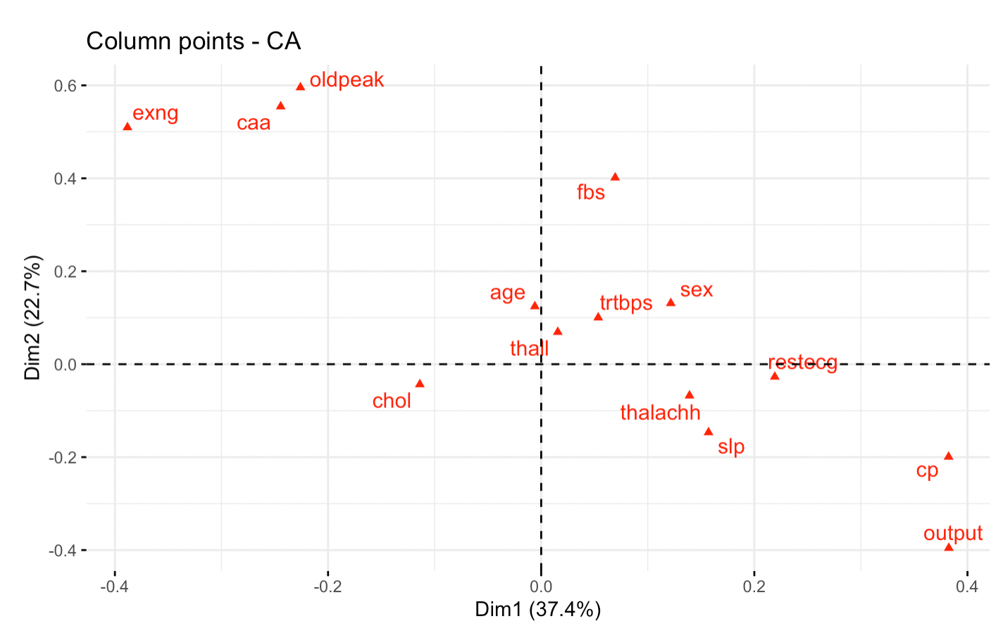
First dimension is highly correlated with ‘fbs’ and ‘oldpeak’

Slide 18
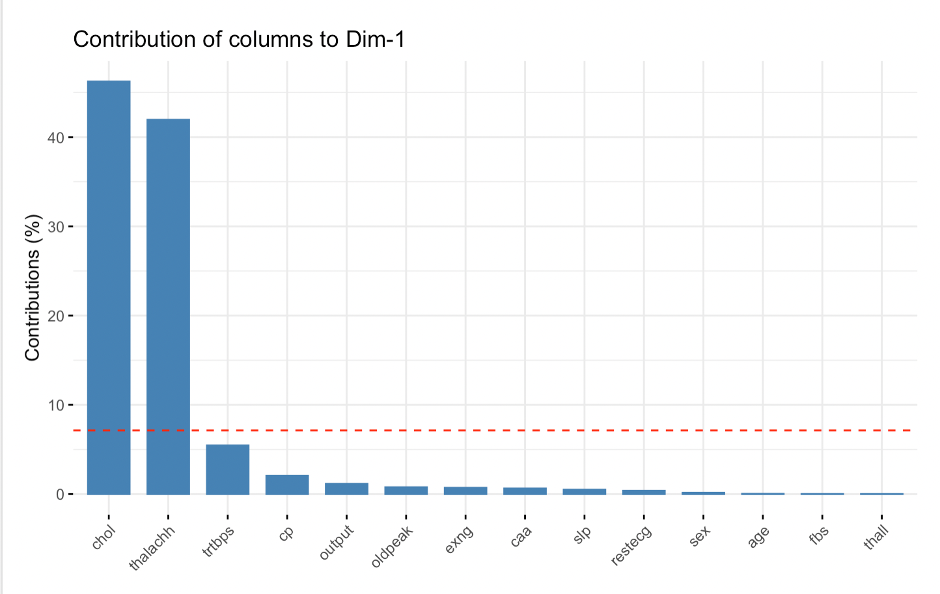
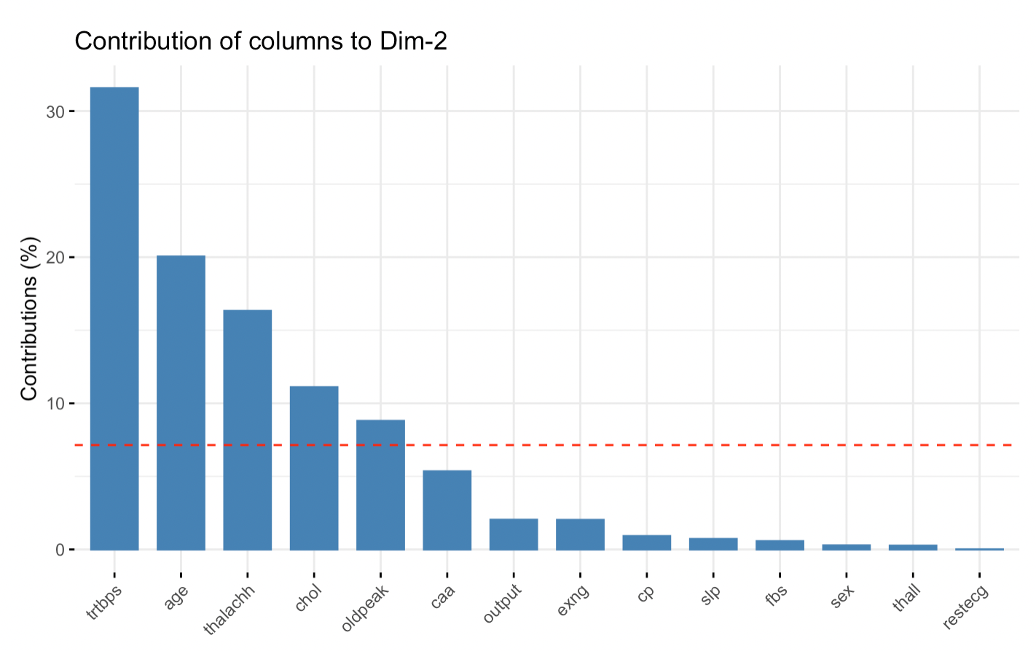
Contribution of Columns
Dimension 1
‘chol’ and ‘thalachh’
Dimension 2
'trtbps', 'age', 'thalachh', 'chol' and 'oldpeak '

Slide 19
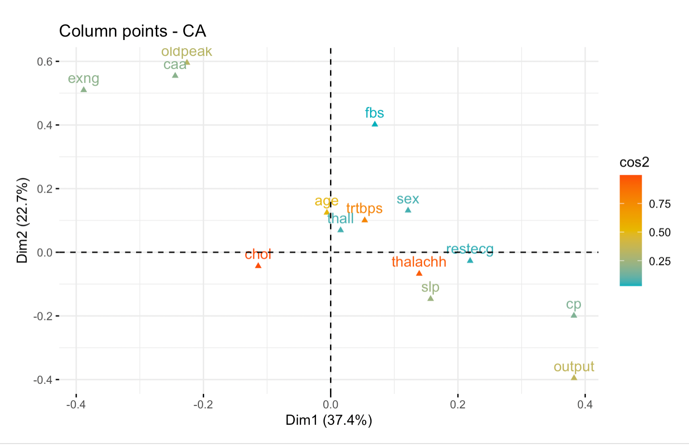
Quality of fit for columns
Chol, trtbps and thalachh are most significant followed by age, oldeprak and output

Slide 20
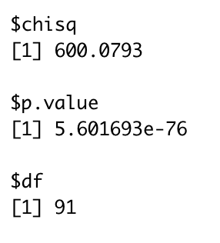
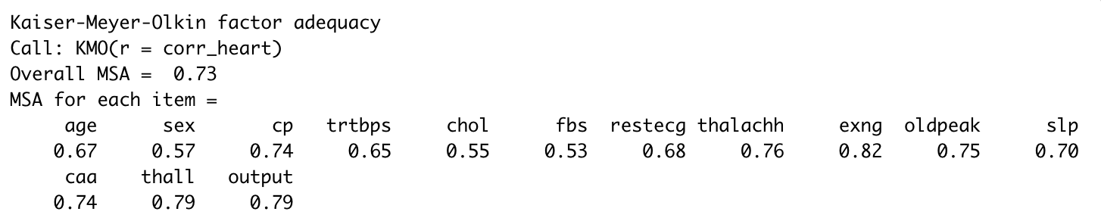
BARLETT’S TEST
KAISER-MEYER-OLKIN (KMO)
The output shows that the p-value for the test came out to be less than the value of threshold value 0.05, hence we can use the dimension reduction on the data.
The Overall score for KMO came out to be 73% which is more than cut-off i.e. 60%, so we can go forward with the dimension reduction.

Slide 21
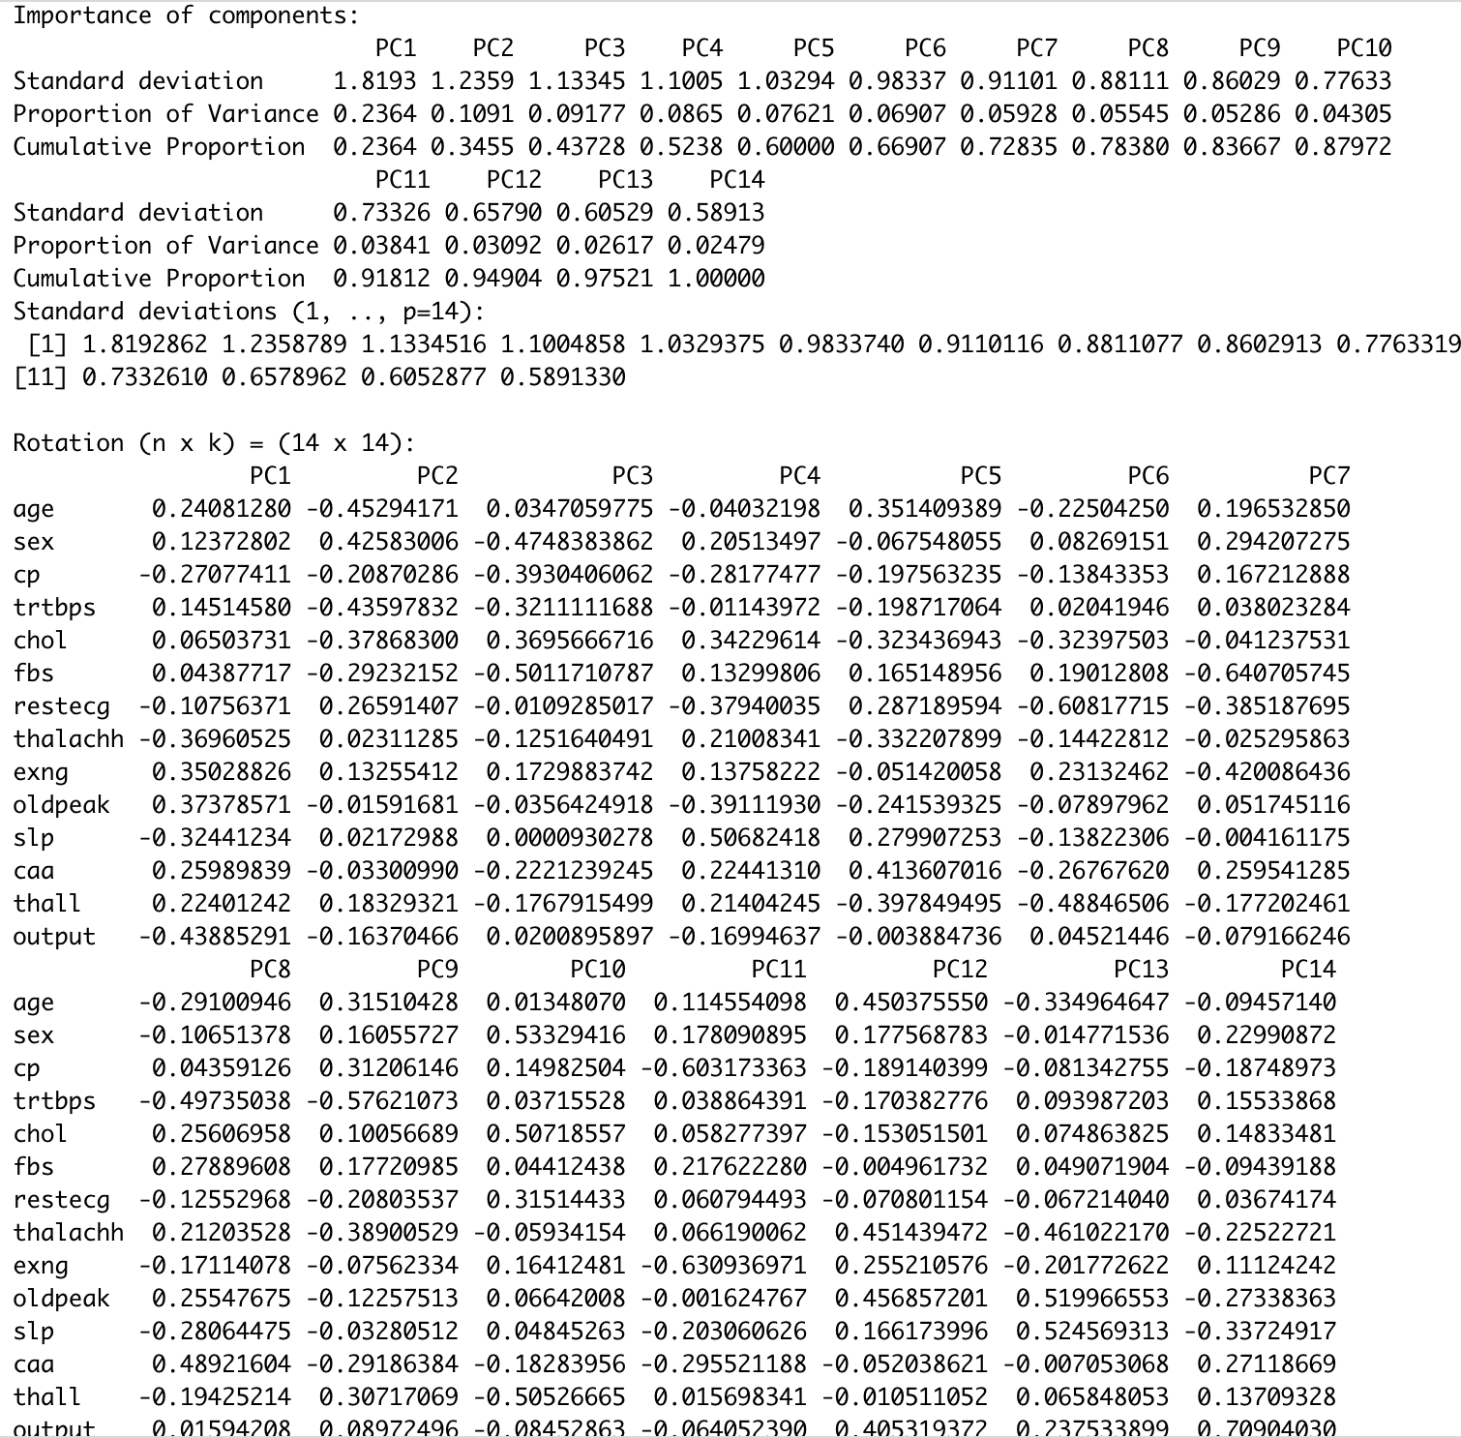
PRINCIPAL COMPONENT ANALYSIS (PCA)
Performed the PCA on the dataset after scaling, it generated 14 Principal Components.
Looking at the Variance of the PC’s,
Calculating variance proportion of the PC’s,
PC1 = 23.3%
PC2 = 11.9%
PC3 = 8.78%
.
.

Slide 22
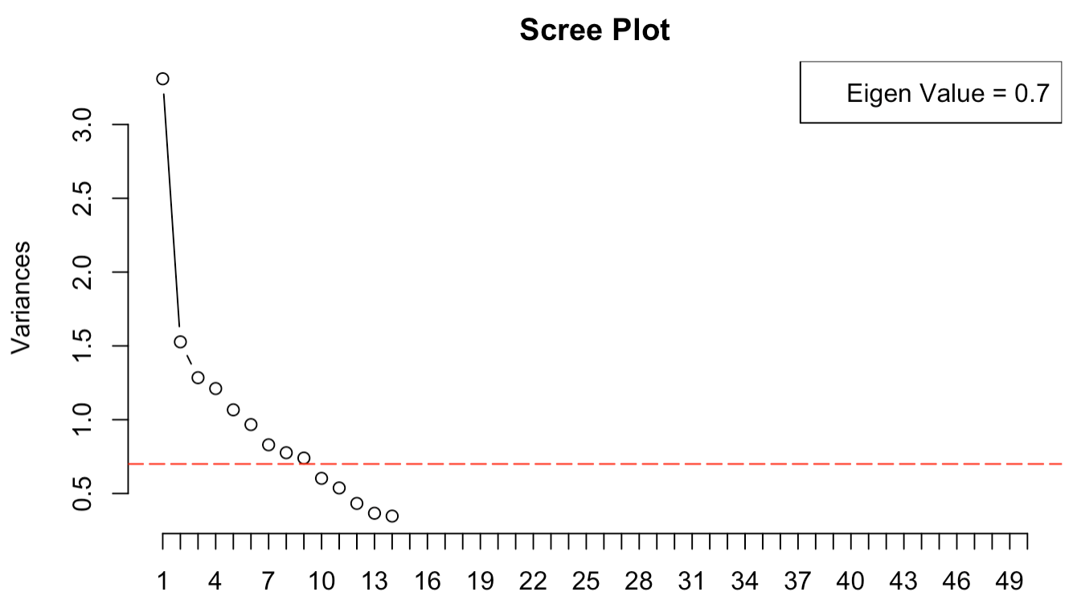
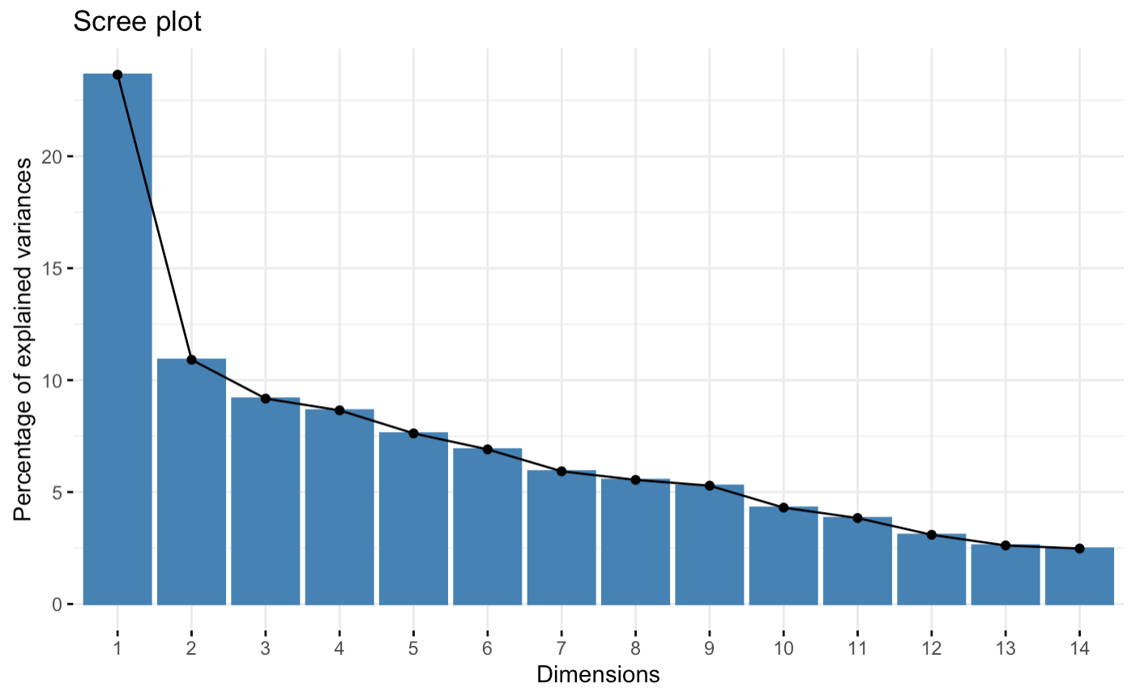
SCREE PLOT
The plot shows around 9 components explains most of the variance in the dataset. We can also say that we have reduced the number of attributes from 14 to just 9.

Slide 23
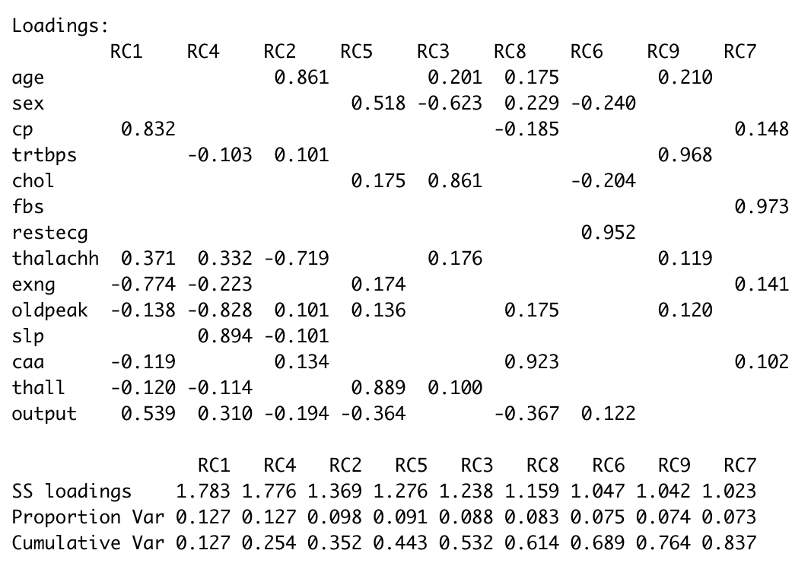
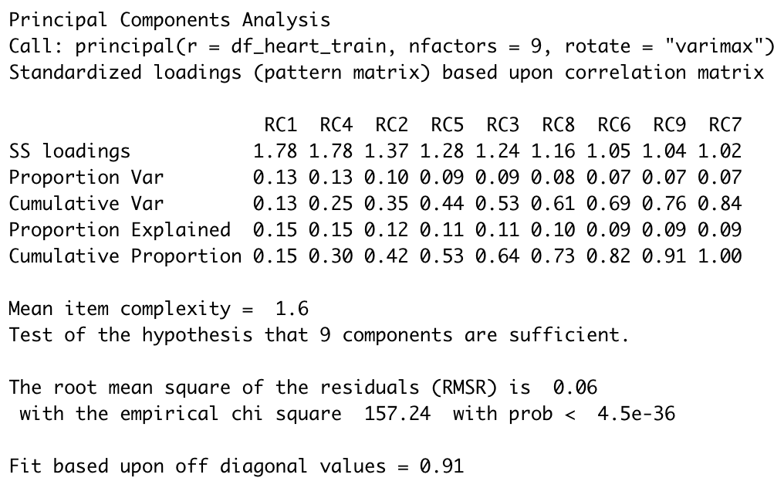
LOADINGS & SUMMARY
Sufficient Factors
9
Cumulative Variance
~ 83.7%

Slide 24
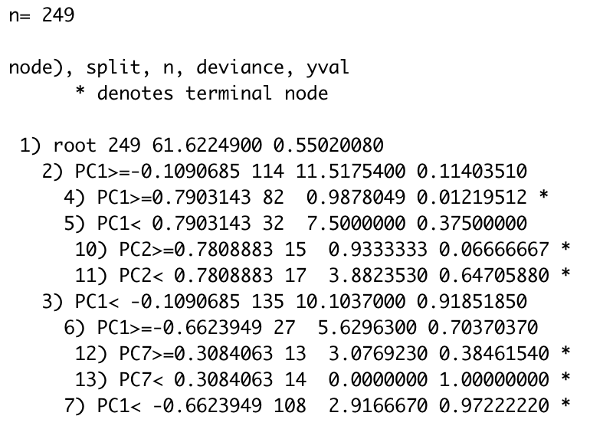
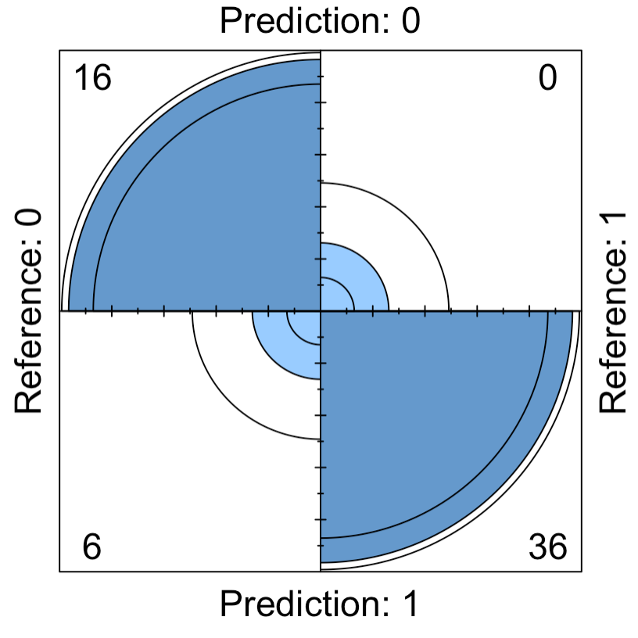
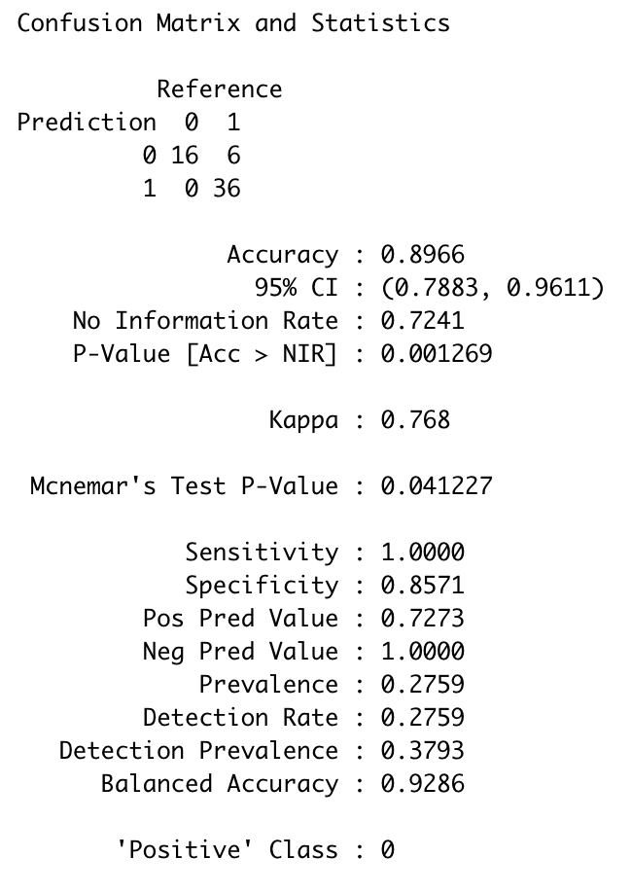
DECISION TREE MODEL
Accuracy
~ 89.6%

Slide 25
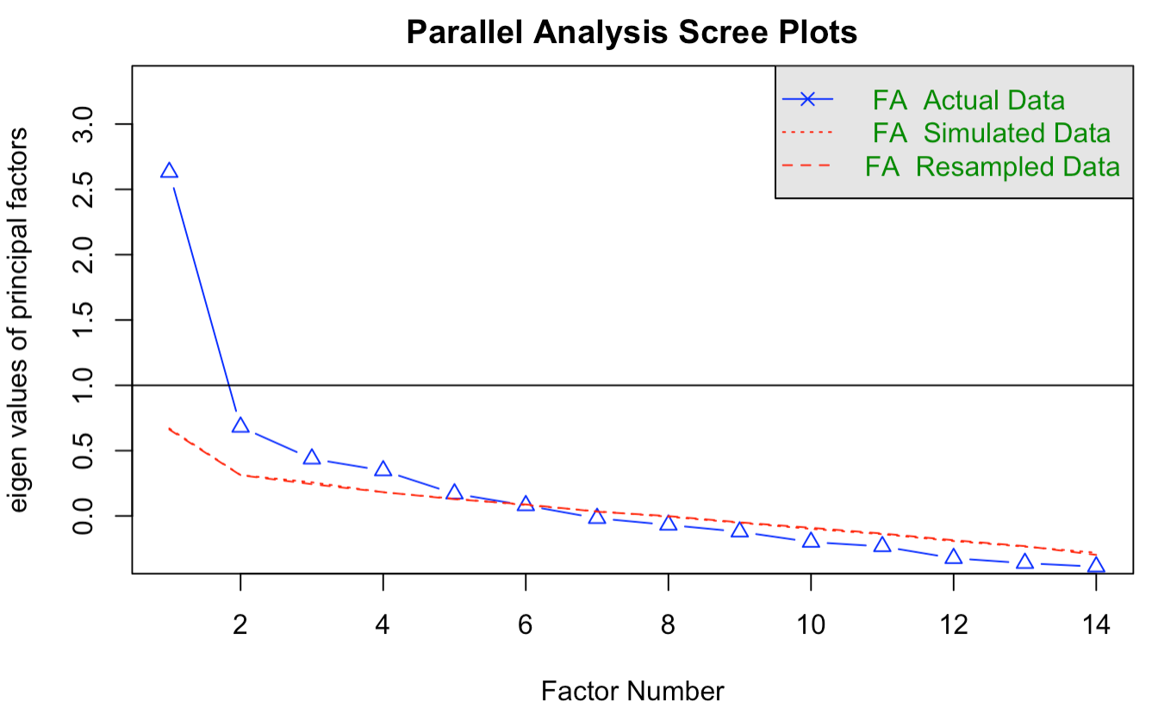
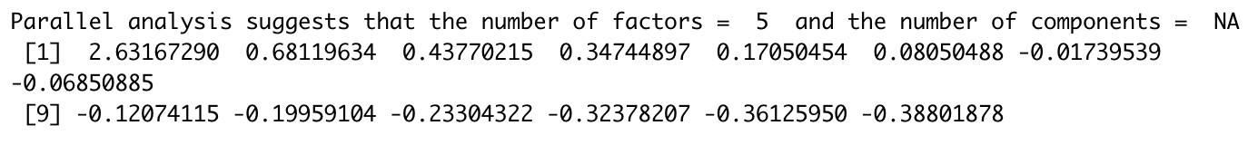
FACTOR ANALYSIS
Sufficient Factors
5

Slide 26
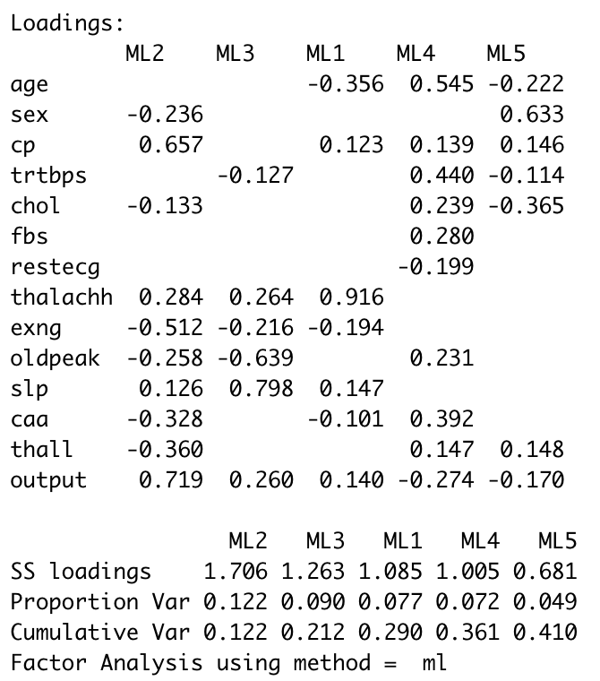
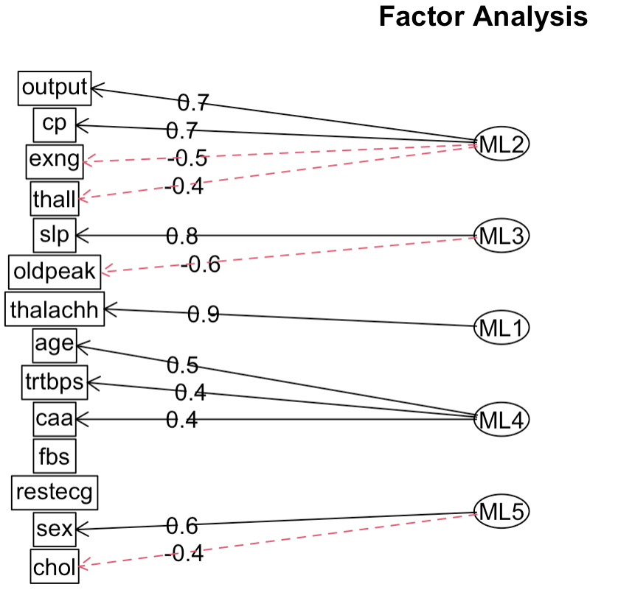
EFA MODEL (VARIMAX)
Cumulative Variance
~ 41%
Factors
5
Rotation
Varimax

Slide 27
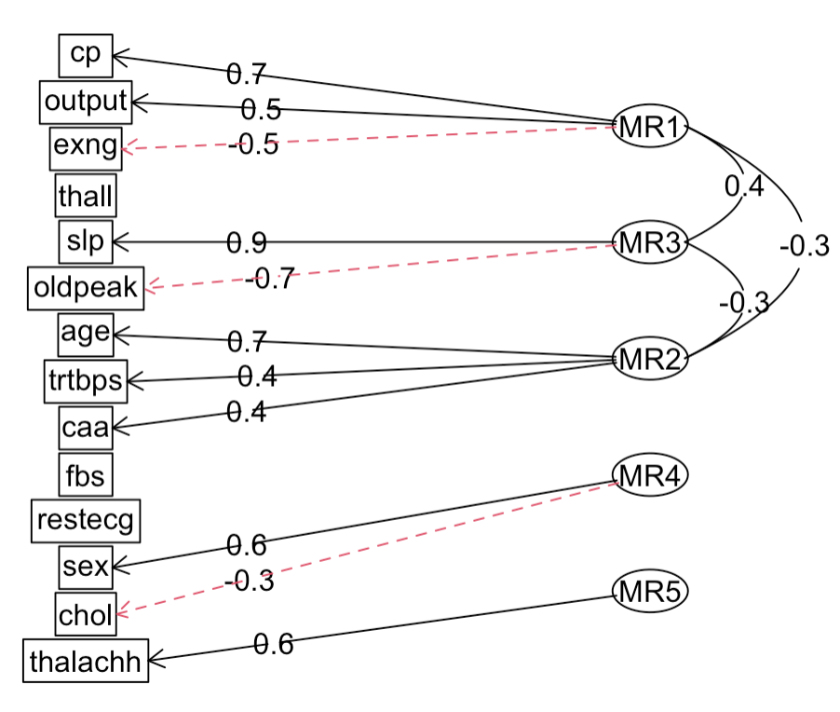
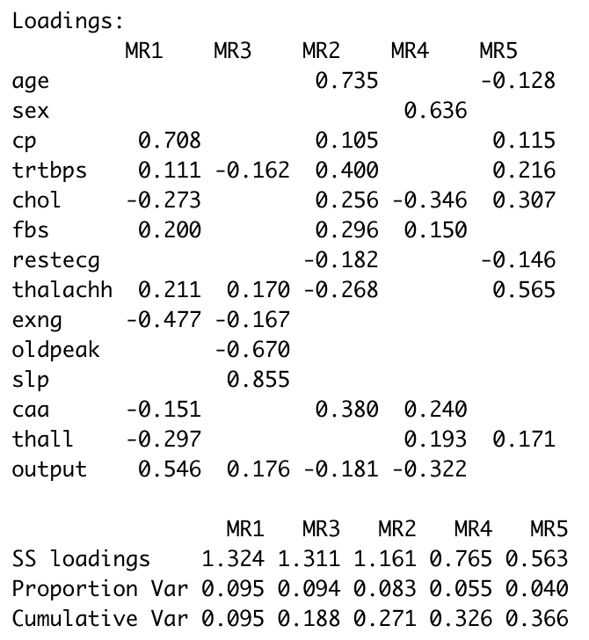
EFA MODEL (OBLIMIN)
Cumulative Variance
~ 36%
Factors
5
Rotation
Oblimin

Slide 28
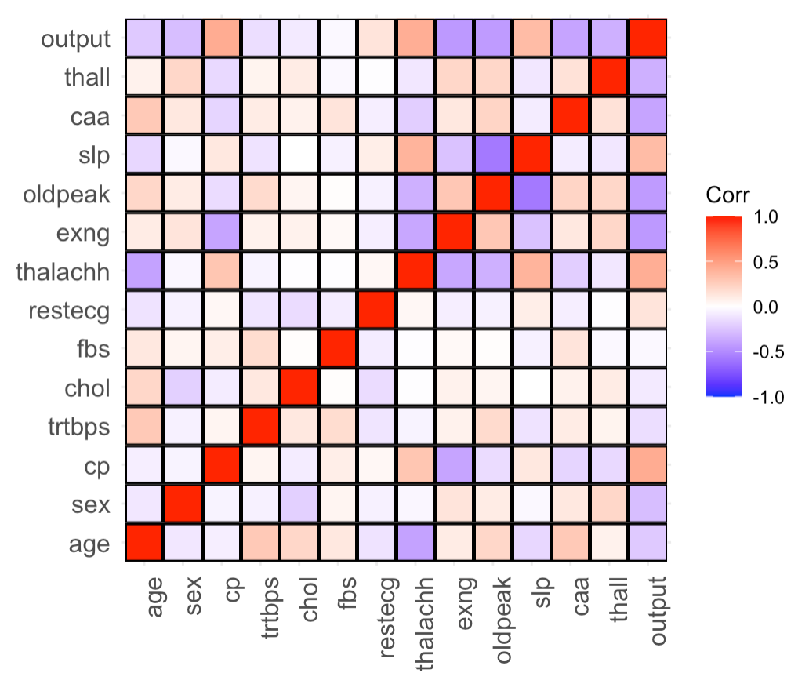
LINEAR DISCRIMINANT ANALYSIS
Correlation
The matrix is generated to find correlation between the features

Slide 29
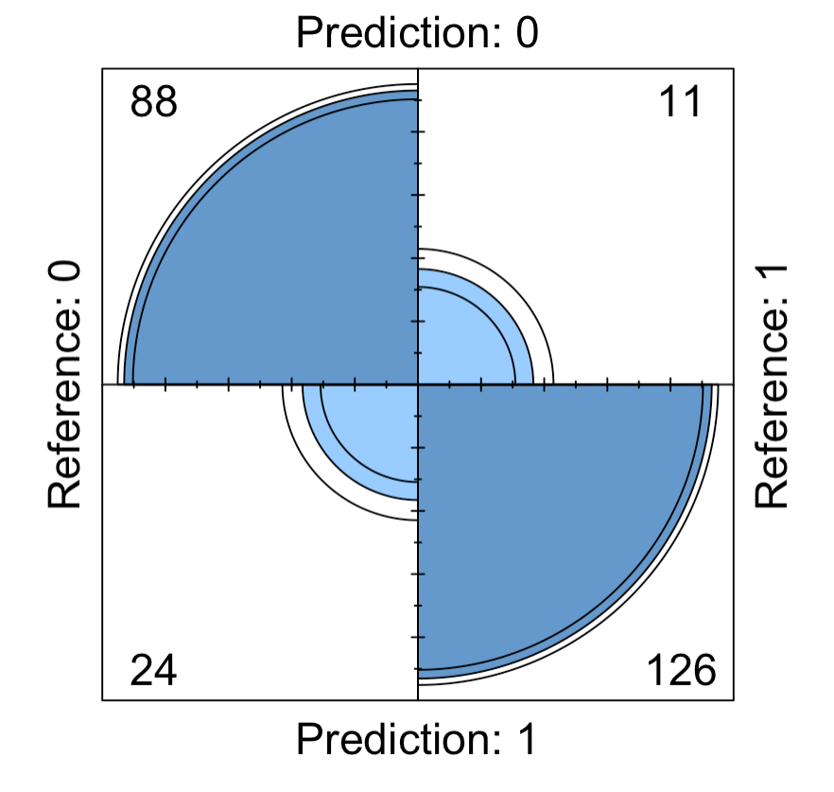
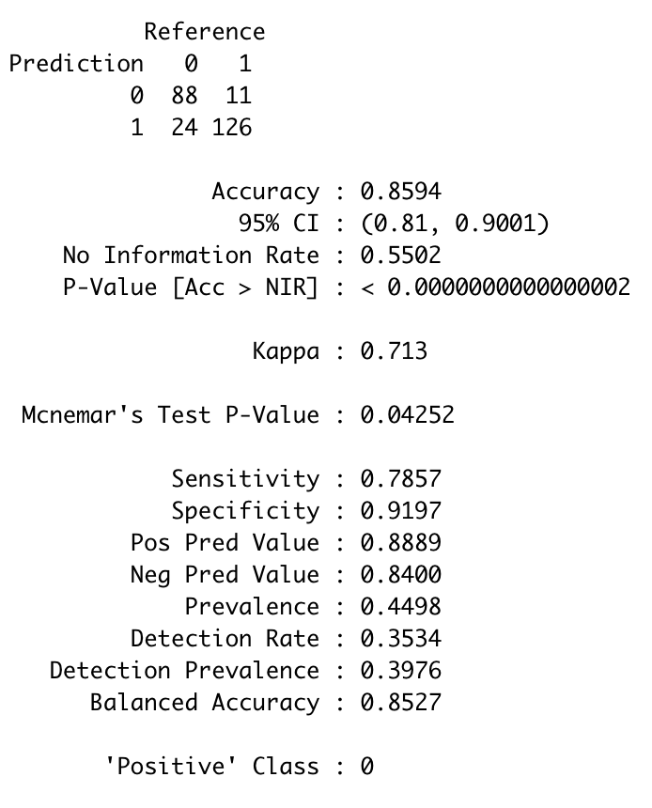
LDA MODEL
Accuracy
~ 85%

Slide 30
SUMMARY
From the start, every method was elaborated for the dimensional reduction without any bias and below is the outcome observed.
Without implementing any dimensional reduction method on the dataset, we have observed ~79.6% accuracy with all variables included.
After data preprocessing, we evaluated the correspondence analysis and get to know about the most significant features in the dataset.
With PCA, we have observed that with 9 factors where cumulative variance contributed to 83.7%
We also implemented the Decision Tree model and observed, accuracy increased to ~89.6%
Factor Analysis we get the optimal factor value to 5 but realized cumulative variance to only ~41%
Exploratory factor analysis corresponds to cumulative variance to ~36% which is a significant decline when we compare it to the PCA method.
LDA method on the other hand has given us sensitivity and specificity of ~78% and ~91% simultaneously leading us to get ~85 % accuracy which we observed the second best after the PCA method.
In summary, we concluded that PCA has done the best job on our use case of heart failure dataset where we want to predict the persons’ tolerance towards heart failure without loosing any underlying information from the dataset and PCA with its 9 principal components has provided us a significant and relevant outcome.

Slide 31

Thank You

